Slide 1

10 Things that you already knew about SSIS A tribute to stupid TAX.
Andreas Bergstedt

Slide 2








Our sponsors

Slide 3
About Me
22+ Years in the IT Industry from Counter Tech to Azure Data Platform Solutions Architect,
Active speaker at the SQL User groups.
Strong focus on practical BI solutions and logical approach to solving business and operational problems.
If it can't be automated it is not worthwhile doing...
Blog: https://blog.bi360.ml/
Twitter:@AndreasBergstedt
E-Mail: Andreas@bi360.ml

Slide 4
Session Summary
Our Sponsors, About Me and this slide – 3 Minutes
Who pays stupid tax? – 5 Minutes
My .dtsx files are corrupted now what? – 2 Minutes
What is a buffer? – 5 Minutes
What is a buffer? Continued… – 5 Minutes
What is Context Switching and why should I care? – 3 Minutes
Can I run 32 separate threads because my server has 32 Cores? – 5 Minutes
How can I speed up my sequential loops? – 5 Minutes
Delta what? – 10 Minutes
Why is my Lift and Shift ADF projects running so slow? – 10 Minutes
Questions – 7 Minutes

Slide 5
Who pays stupid tax?
Stupid tax: an additional (and generally avoidable) taxation upon your regular habits.
Notes:
an additional (and generally avoidable) taxation upon your regular habits

Slide 6

Who pays stupid tax?
Notes:
-After the music video lead into the next segment

Slide 7
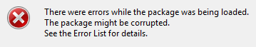
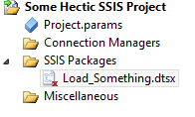
My .dtsx files are corrupted now what?
How to fix this:
Manual editing (Bad Idea)
Get the latest copy from a friend (Highly improbable)
Refresh the solution from Source Control (What if it was never checked in)
Or maybe….

Slide 8
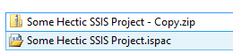
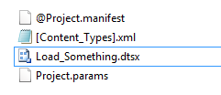
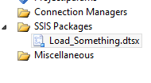
Restore the last build from your .ispac
Open the <SSIS Project Path>\Bin\Development\ folder
Rename the <My Solution Name> .ispac to <My Solution Name>.ZIP
Open the .zip file and copy the last .dtsx file that is corrupted back to your Solution replacing the corrupted file.
Open the Project again and…. Your smiling.

Slide 9
What is a buffer?
The data flow engine in SSIS uses a buffer oriented architecture to efficiently load and transform datasets in memory thus eliminating disk based operations….
DefaultBufferSize :
64KB to 8GB with 10MB Default
DefaultBufferMaxRows :
Set to 10,000 by default with no documented maximum value

Slide 10
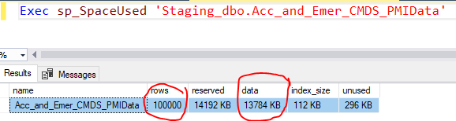
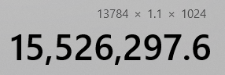
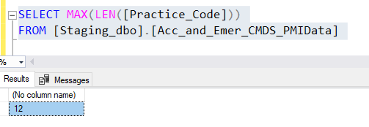
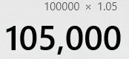
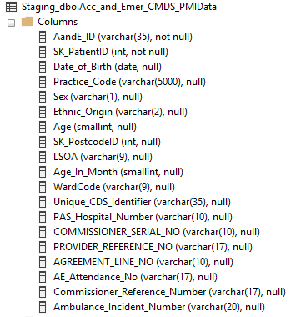
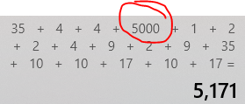
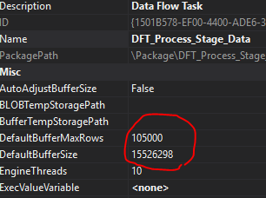
What is a buffer? - Continued
Buffer Calculation:
DefaultBufferSize = Row Size * expected rows +10%
DefaultBufferMaxRows = Max Expected rows +5%

Slide 11
What is Context Switching and why should I care?
In computing, a context switch is the process of storing and restoring the state (context) of a process or thread so that execution can be resumed from the same point at a later time. This enables multiple processes to share a single CPU and is an essential feature of a multitasking operating system.
Notes:
In computing, a context switch is the process of storing and restoring the state (context) of a process or thread so that execution can be resumed from the same point at a later time. This enables multiple processes to share a single CPU and is an essential feature of a multitasking operating system.

Slide 12
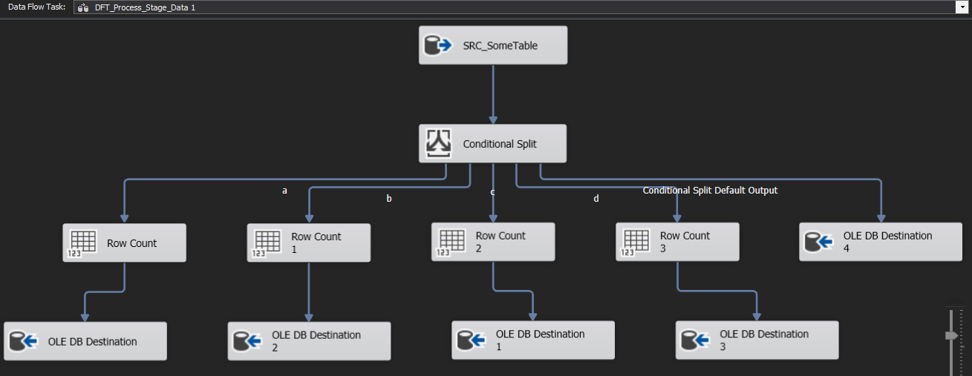
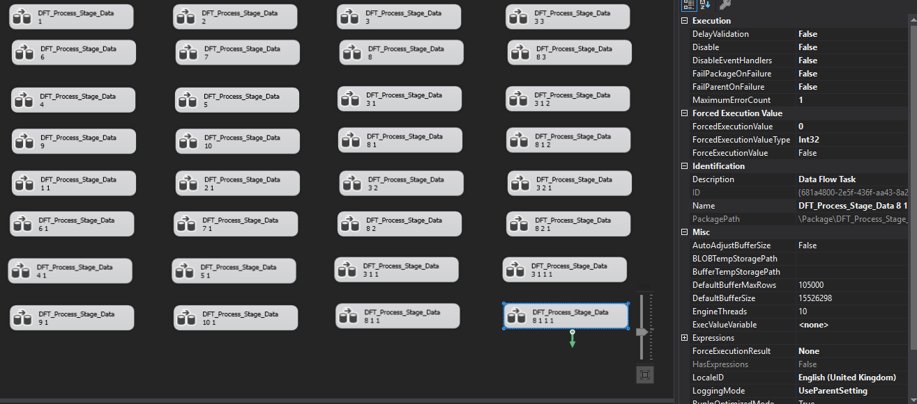
Can I run 32 separate threads because my server has 32 Cores?….

Slide 13
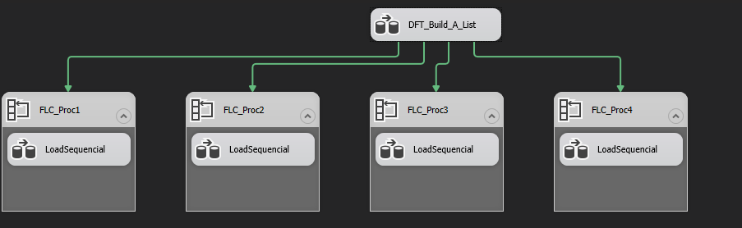
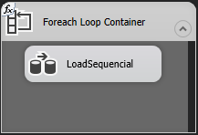
How can I speed up my sequential loops?
Notes:
Sequential loops are slow….
SSIS is not dynamically scaled but you can build out simple for each loops in pralel executions

Slide 14
Delta what?

Slide 15
Why is my Lift and Shift ADF projects running so slow?
Data Proximity
Auto Run-Time or Self Hosted Runtime
ETL vs ELT
Data Boundaries

Slide 16
Questions??
Slides and more available at : https://github.com/ex-tc
Blog: https://blog.bi360.ml/
Twitter: @AndreasBergstedt
E-Mail: Andreas@bi360.ml

